Slide 1
Multi-Agent with DSPy and Databricks
Enhance your Agent workloads with Classic Machine Learning
Austin Choi, Delivery Solutions Architect

Slide 2
Forward-looking Statement
This presentation has been prepared for informational purposes only. The information set forth herein does not purport to be complete or contain all relevant information. Statements contained herein are made as of the date of this presentation unless stated otherwise.
This presentation and the accompanying oral commentary may contain forward-looking statements. In some cases, forward-looking statements can be identified by terms such as “may”, “will”, “should”, “expects”, “plans”, “anticipates”, “could”, “intends”, “projects”, “believes”, “estimates”, “predicts”, or “continue”, or the negative of these words or other similar terms or expressions that concern Databricks’ expectations, strategy, plans, or intentions.
Forward-looking statements are based on information available at the time those statements are made and are inherently subject to risks and uncertainties that could cause actual results to differ materially from those expressed in or suggested by the forward-looking statements.
Forward-looking statements should not be read as a guarantee of future performance or outcomes. Except as required by law, Databricks does not undertake any obligation to publicly update or revise any forward-looking statement, whether as a result of new information, future developments or otherwise.

Slide 3
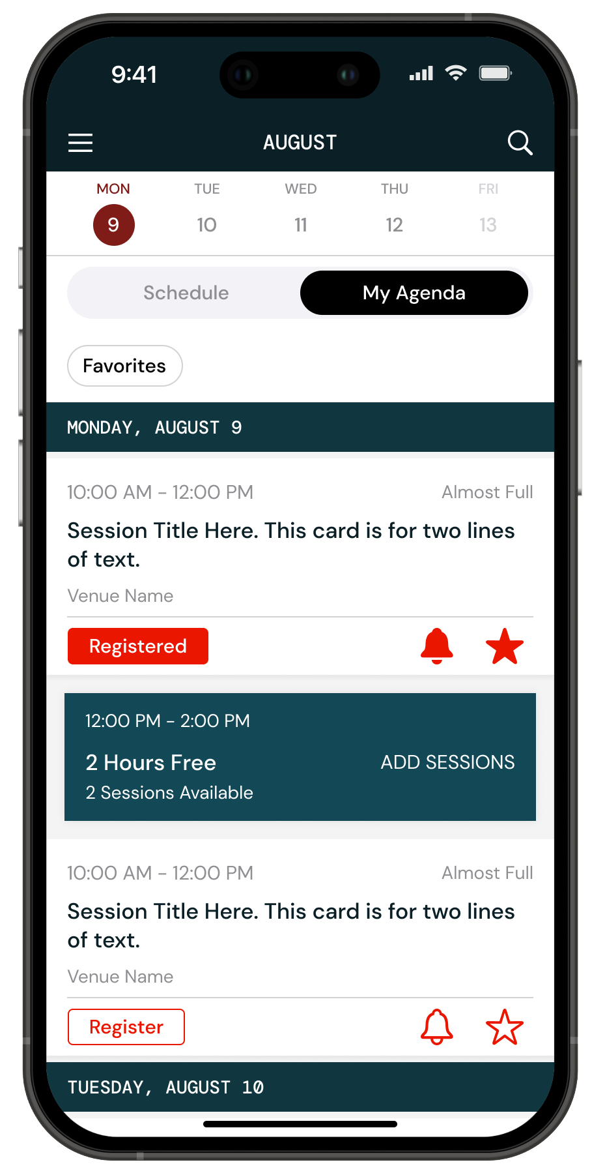
Complete Your Surveys
Your feedback has a direct impact on Data + AI Summit content
You will receive a survey for each session attended
Open the Databricks Events app and select “My Surveys” from the menu
Surveys can also be submitted in the Attendee Portal

Slide 4









About Me
Background:
Austin is Delivery Solutions Architect at Databricks who specializes in Data Science and GenAI. He has helped deploy agent powered solutions for various customers at Databricks and delivers workshops to help customers understand what GenAI is and how to do it on Databricks. If there’s anything DSPy related, he’s your guy!
Before Databricks, he completed Data Science projects at Deloitte, IBM and Cisco.
He has two adorable cats with one that impersonates a dog. He swims, plays video games (the good ones) and tinkers with software and hardware.
Austin Choi
Delivery Solutions Architect
Geographic Location
Los Angeles, CA
Check me out!
Interests!
Fun Facts:
Lived in CA, then VA, then NC, then back to CA
Taught my cat how to sit, shake and jump
Pronounces GIF like JIF or with a soft g
Contact!

Slide 5
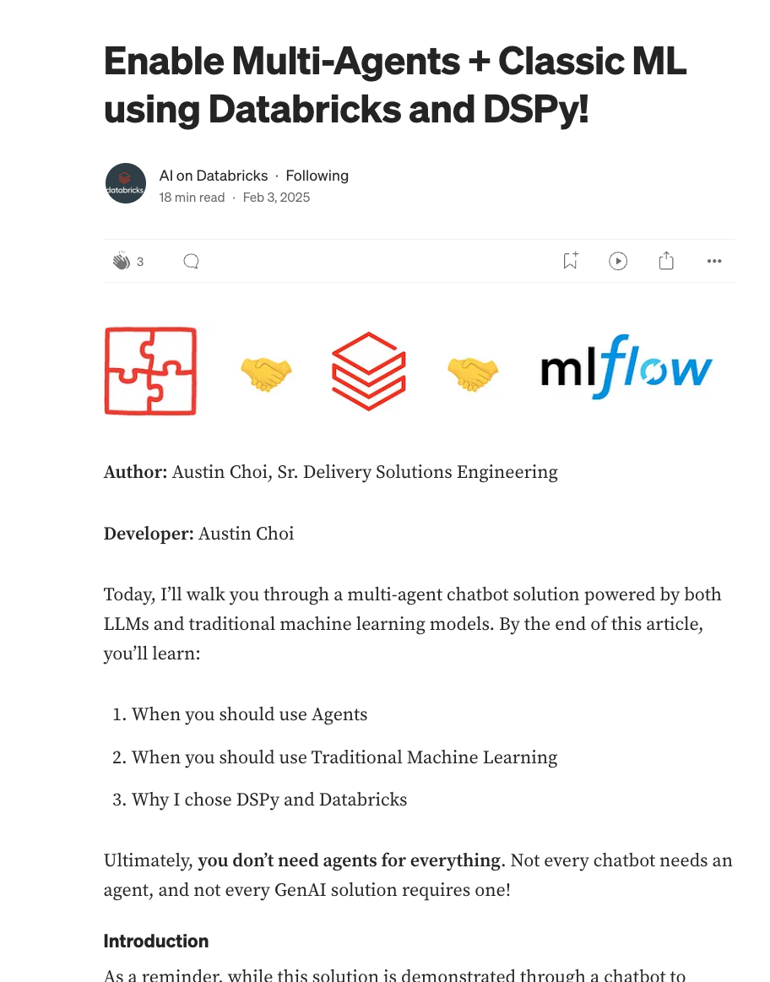

Original Medium Article Here
QR Code to the article

Slide 6
Let’s Level Set…
What’s an Agent?

Slide 7
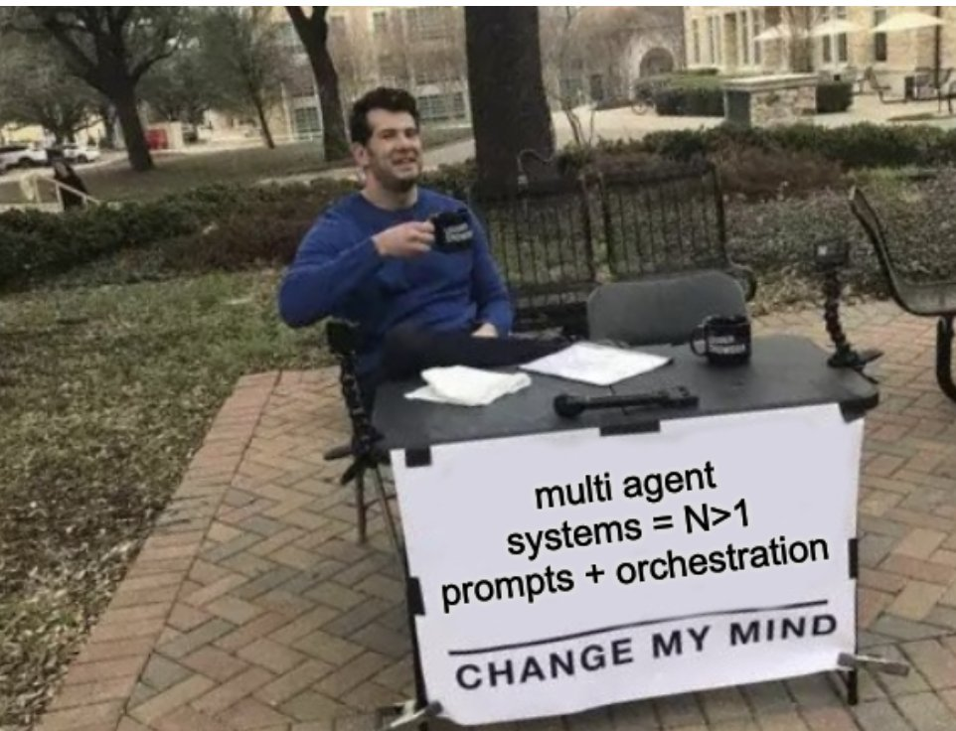

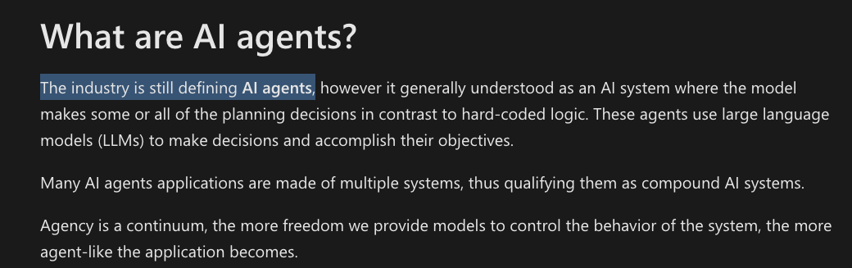
Disagreements on what makes something “Multi-Agent” or even an “Agent”

Slide 8
Agents don’t need to be complicated
The simpler and clearer the task, the better the agent
What we learned:
Smaller models and classic ML reign supreme
Don’t make things too complicated
For some use cases, GenAI alone is still too inconsistent
Function/Tool Calling is nearly mandatory
Agent Code is redundant and difficult to maintain

Slide 9

How Factset built their agent system
GPT4
59%
accuracy
15s
latency
General Intelligence
vs
Agent System
85%
accuracy
6s
latency
Data Intelligence

Slide 10
How Factset built their agent system
GPT4
59%
accuracy
15s
latency
General Intelligence
vs
Agent 1
Retrieve proprietary FQL formulas
Agent 2 Apply specific query instructions
Agent 3 Generate numerical arguments
Agent 4 Generate final formula
85%
accuracy
6s
latency
Vector Search
Fine-tuned OSS model
OSS model with function calling
Commercial LLM
Agents that can reason over your data and leverage tools
Custom evaluation for your use case
Governance across data and models

Slide 11




















Labeling UI
Evaluation Data
Agent Evaluation
User Requests / Traces / Evaluation Data
Review & correct evaluation data
Generate synthetic data
Evaluate quality/cost/latency
View metrics & agent outputs in UI to debug quality
Custom App
Agent Evaluation
Custom apps / UI
Databricks Apps
Model Serving
AI Gateway
Agent deployment
Unity Catalog
Agent Framework
Open source/ custom LLMs
Commercial
LLMs
End
User
REST APIs
Request/response
User feedback
Agent code
Code packaging
Tracing for observability
Review app (chat UI w/ feedback)
AutoGen
Agents¹
Agent
Agent Evaluation
OpenAI SDK
Use data in agent
Tables
Vector Search
Log & Version
Genie
Room
Logs & Traces
User feedback
Tool code
Log & Version
Tools²
Serverless SQL
Prototype Agents
Monitor quality/ cost/ latency
Online Tables
AI/BI Dashboard
Use tools in agent
AI Playground
Serverless Compute
Data Flows Via Inference Tables
Measure quality/cost/latency
Review production logs in UI
Add logs to evaluation set
Agent Evaluation
Quality evaluations
Latency / usage
1. Stored as UC Models; 2. Stored as UC Functions

Slide 12
Get the most out of your system
Multi-Agent Tips and Tricks

Slide 13
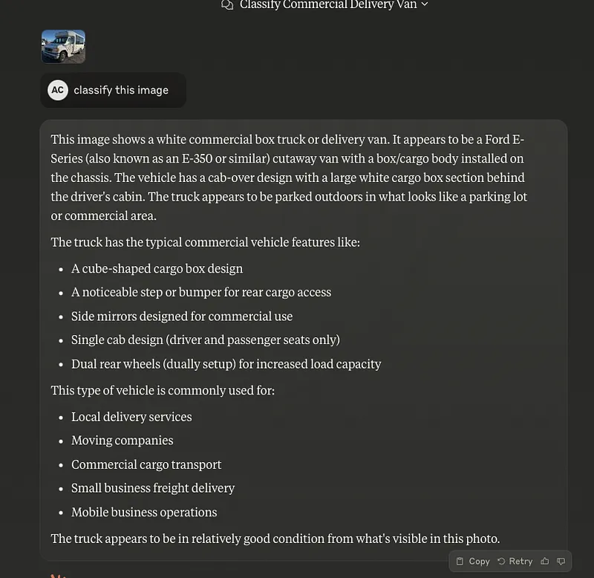
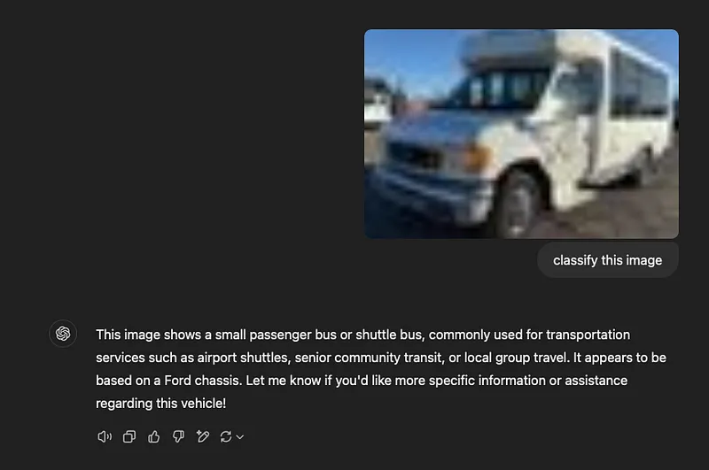
Tip 1: Use Classic Machine Learning
Classical Models can shine brightly if used for specific use cases
State of the art Multi-Modal models can cost about $1 for 20 requests per hour depending on the size of the image
And take a few seconds

Slide 14
Tip 1: Use Classic Machine Learning
Classical Models can shine brightly if used for specific use cases
An image classification model like Vision Transformers can cost $0.7 per hour for hundreds of thousands of requests

Slide 15

Tip 2: Use Smaller LLMs or Fine Tune them
At significantly smaller cost with high speed, smaller LLMs are more suitable for simpler tasks
Image Classification Endpoint
Powered by a Vision Transformer
Model Serving Agent
Powered by Llama-8B
Processes and sends valid inputs to an Model serving endpoint
Forecasting Model Endpoint
Powered by ARIMA
We can take advantage of the simple task processing text and send it to a model serving endpoint

Slide 16
Tip 3: Use Function Calling to hit Services
Don’t build from scratch, take advantage of existing services tailored to specific tasks to better enhance your agents.
Customize the API call depending on User Input
Assistant #1
Genie Spaces API
Triage Agent
Assistant #2
Model Serving Endpoint
One agent to determine which endpoint to hit per session
Assistant #N Other endpoints

Slide 17
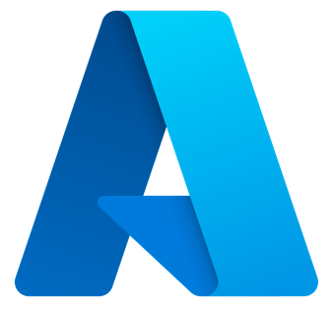




Tip 4: Manage in one place
The Lakehouse and Unity Catalog allows you to manage your pipeline, data, agents, models with governance all in one platform
Lakehouse capability (Data + AI)
Databricks AI capability (AI)
MLOps + LLMOps
Asset Bundles (DABs)
CI/CD support
MLflow
Prepare Data & Vectors
Prepare data & features with native tools
Build & Evaluate Models
Train or fine-tune custom models; prompt engineer pre-trained models
Serve Applications
Serve models into real-time apps & monitor
Notebooks w/ ML Runtime
AI Playground
MLflow Track & Evaluate
Notebooks
Delta Live Tables
AI Functions
Models from SQL
Lakehouse Monitoring
AutoML
Fine Tuning
SQL
Workflows
Model Serving
Lakehouse Apps
Models in Marketplace
Serve Data & Vectors
Function Serving
Vector Search
Feature Serving
Governance
Unity Catalog
Feature Store in Unity Catalog
Model Registry in Unity Catalog
Data Platform
Delta Tables
Structured Data
Files (Volumes)
Unstructured Data

Slide 18
Step by Step Demo
See it in Action

Slide 19
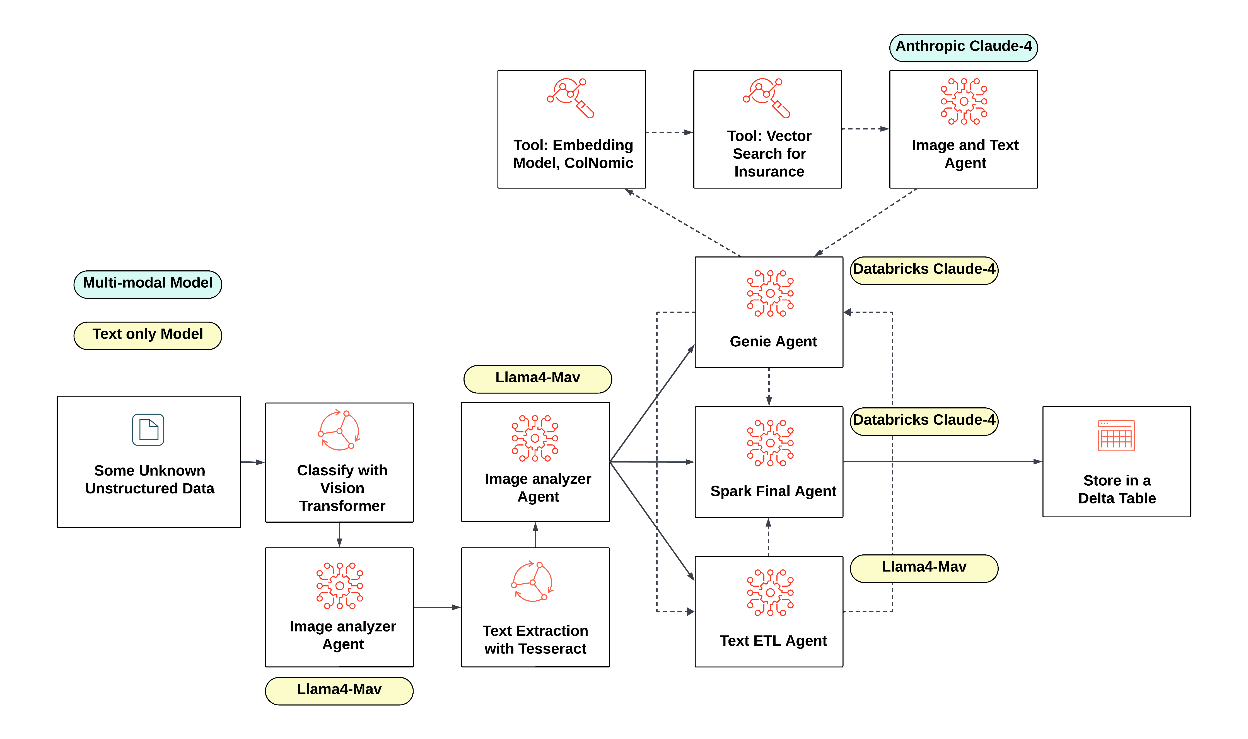

Slide 20

Thanks for joining!
QR Code to
the article
Contact!

Slide 21


